Slide 1
Role Based Permissions

Slide 2
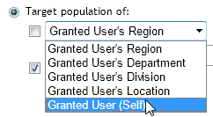
What are Role Based Permissions?
Role-based permission management allows you to have as many roles in the system as your company requires, while at the same time granting each role a different level of permission granularity.
With the role-based permission framework, you can choose to grant control based on the work the manager performs as well as control the number of employees they have permission to access.
The power of RBP is in the level of granularity.
Example: Managers in Germany can view/edit information related to Employees in Germany & France
When granting roles to users, you can specify automatic granting rules so that new employees joining the organization will automatically inherit the permissions defined for their specific role.

Slide 3
Role Based Security Concepts
The role defines access to data and functionality=Permissions
Roles are granted to groups of users (left circle)
Granted users may perform the role on target users (right circle)
Groups can be dynamic to automate assignment of permissions
Granted
Users
Target
Users
Role
Notes:
The green box in this diagram represents a role, and groups of users are represented by the two yellow circles.
The role defines access to data and functionality. This is where you define what you want your role to do in SuccessFactors. For example, should the role be allowed to view dashboards?
Once the role is defined, you grant the role to groups of users represented by the left circle.
Lastly you restrict the granted users to perform the role on target users. For example, you may decide that managers (the left circle) can view dashboards (defined in the role) on their team (the right circle).
Groups can be dynamic which allows us to automate the assignment of permissions. For example, a group of granted users can be “All employees in the Sales department”. As employees are transferred into and out of the sales department, their permissions with automatically adjust.
Administrators can define many roles.

Slide 4
Step 1: Create the Groups
The setup process follows these steps:
Step 1: Create the groups (yellow circles)
Step 2: Create the role and permissions
Step 3: Grant the role (link role to groups)
Granted
Users
Target
Users
Role
Notes:
There are three steps to setting up permissions in this new framework:
Create the groups – define the groups you want to grant and target.
Create the role – define the role. What data can the role access (live profile data - fields and background sections)? What actions can the role perform (actions like create performance review form, or perform succession planning)?
Grant the role. Link the Green Box (role) to the Yellow Circles (groups).

Slide 5
Managing Permission Groups
The first step in managing security is to create permission groups.
In Admin Tools, navigate to Set User Permissions > Manage Permission Groups
Click Create New to create a new permission group
Remember that you’ll create two permissions groups (for those exceptions)
Granted users
Target users

Slide 6
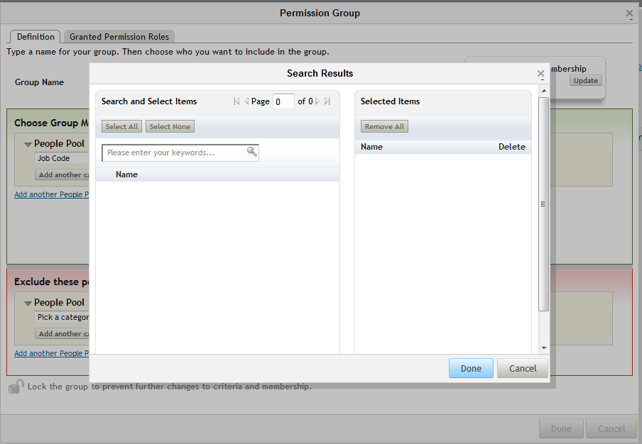
Managing Permission Groups
Set up a group using job code

Slide 7
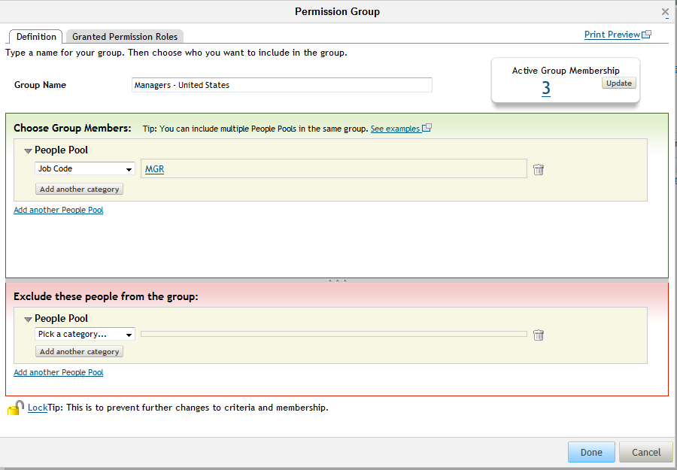
Managing Permission Groups
Update the Active Group Membership

Slide 8
Step 2: Create the Role
Step 1: Create the groups DONE
Step 2: Create the role
Step 3: Grant the role
Granted
Users
Target
Users
Role
Notes:
Step 1 is now complete (we have created all four groups represented by the yellow circles)
Now for Step 2: Create the role.

Slide 9
Managing Permission Roles
A permission role defines access to data and functionality
In Admin Tools, navigate to Set User Permissions > Manage Permission Roles
Click Create New to create a new permission role.
Note: Some Roles are standard (Employee, Manager, Matrix Manager, HR Rep) and don’t need Groups.

Slide 10
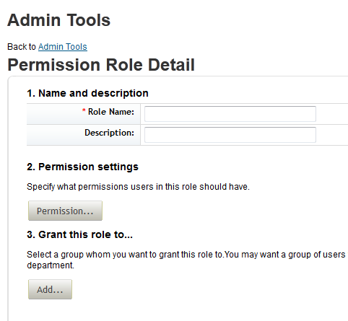
Manage Role-Based Permission Access
Create a new role

Slide 11
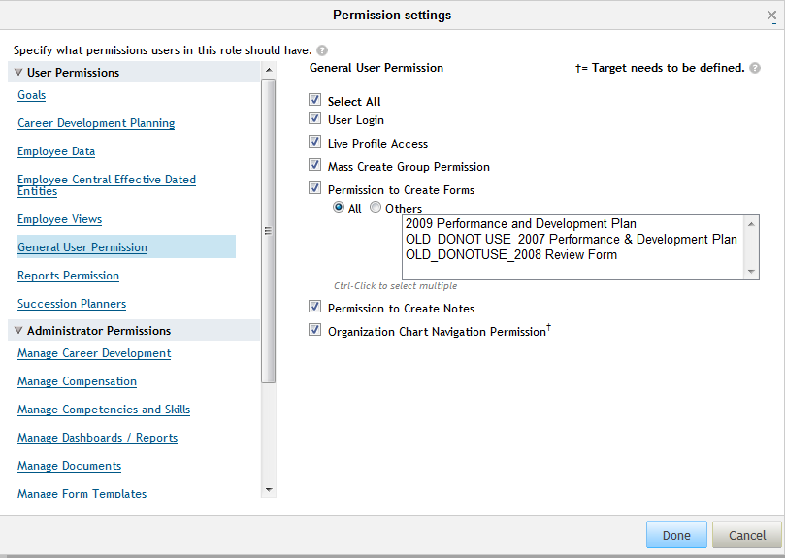
Manage Role-Based Permission Access
Set permissions for the role

Slide 12
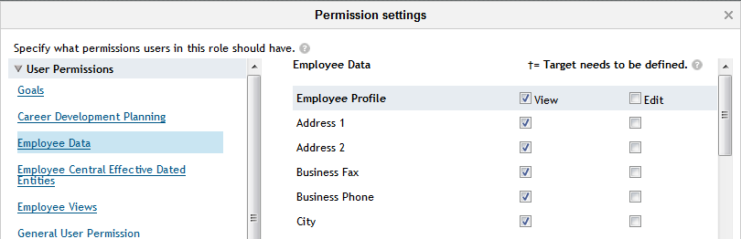
Set Permissions for the Profile
Also enable the following for the All Managers permissions role:
User Permissions > Employee Data > Employee Profile: select the View checkbox. This will make all the Employee Profile fields visible
User Permissions > Employee Views > Profile: check the "View" checkbox

Slide 13
Step 3: Grant the Role
Step 1: Create the groups DONE
Step 2: Create the role DONE
Step 3: Grant the role
Granted
Users
Target
Users
Role
Notes:
Now that Steps 1 and 2 are complete, we can move on to Step 3. Here we will grant the role to users (link the green box (role) to the yellow circles (groups)).

Slide 14
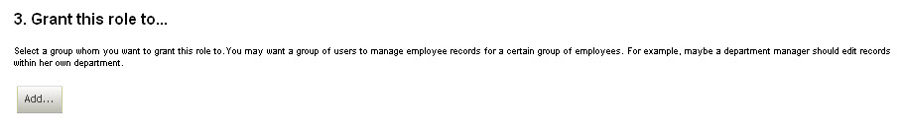
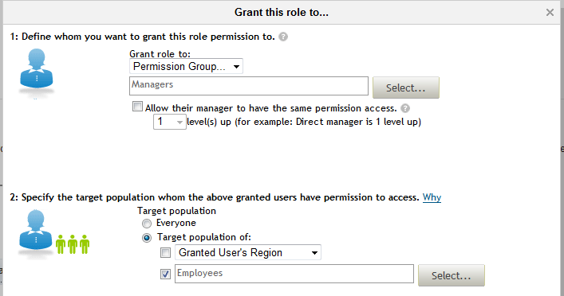
Granting Role to Users
Granted
Users
Manager Role
Target
Users
Click the Select button to add the groups
Notes:
Granting the role is accomplished within the role you created, in this example we created the HR Role in Step 2. You will grant roles by selecting the “Add..” button on this page.
In the Grant Role dialog:
Select your access groups.
Select your target groups.
In this example we will grant this role to Human Resources in Germany and Human Resources in the United States groups that we created in Step 1 with the target group of Employees in Germany and Employees in the United States, respectively. You will use the “Select” button to search for the groups you created in Step 1.

Slide 15
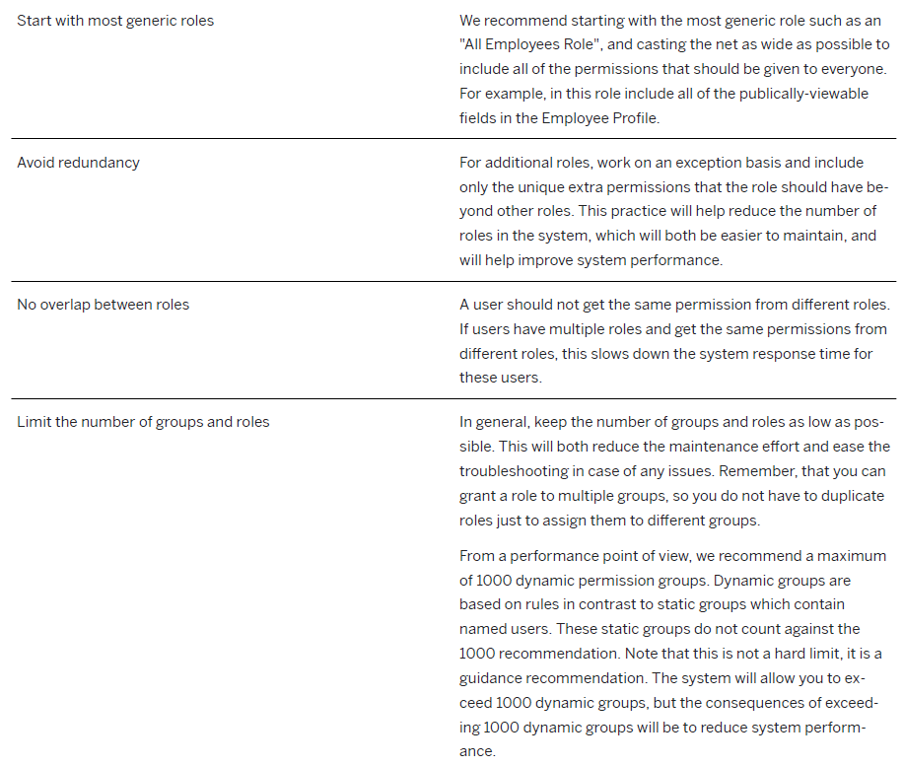
Best Practices for RBP

Slide 16
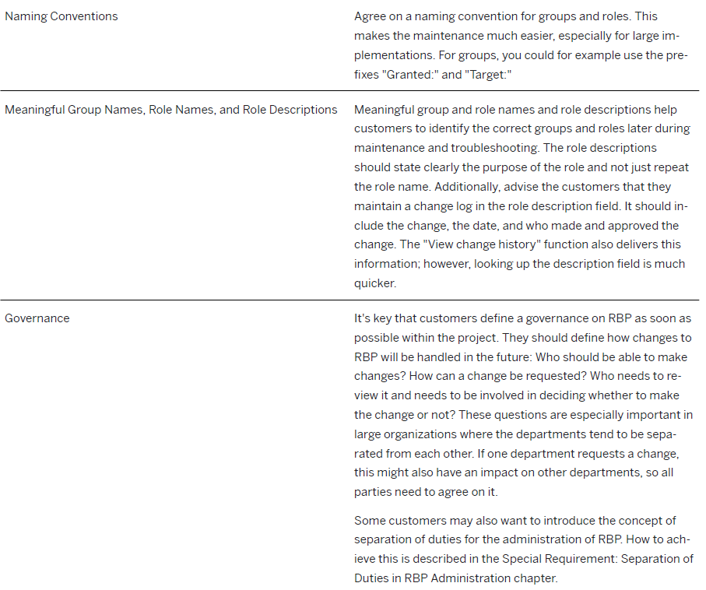
Best Practices for RBP cont.

